Slide 1
REAL-TIME EXPENSE TRACKER ( Using Swing , AWT)
Presented by:-
Nikhil pal (RA2311028030038)
Ashwin Chaudhary (RA2311028030034)
Arnav Tomar (RA2311028030030)
Aryan Verma (RA2311028030033)

Slide 2
INTRODUCTION
This project aims to develop a simple Expense Tracker App using the Java programming language.
The app helps users record and monitor their income, expenses, and balance to manage their personal finances effectively.
The project integrates Graphical User Interface (GUI) components using Java Swing to provide a user-friendly interface.
Data is maintained locally, providing users with an overview of their spending habits and financial health.

Slide 3
PROJECT IDEA AND INFORMATION
Purpose:
The primary goal of the Expense Tracker App is to provide users with a simple tool for recording and categorizing their daily transactions (income and expenses).
It helps users manage their budget , keep track of their balance, and generate reports on their spending patterns.
Features:
Income/Expense Management: Add, categorize, and track transactions.
Balance Maintenance: Calculate total income, expenses, and balance in real time.
Report Generation: Generate reports to display total spending by category.
Simple User Interface: GUI for easy data entry and overview of transactions.
Technologies Used:
Java for backend processing.
Swing for GUI components.
JTable, JTextField, JComboBox, and JButton for transaction input and display.

Slide 4
WORKING OF THE EXPENSE TRACKER
Main Window: The user interacts with the main window, which has fields to input the amount, description, and category (income or various expenses like food, utilities, etc.).
Transaction Entry:
Users input details such as transaction amount, category, and description using text fields and drop-down menus.
The "Add Transaction" button adds the transaction to a table, and the app updates the total income, total expenses, and balance dynamically.
Data Display:
All transactions are displayed in a JTable with columns for amount, description, and category.
Users can easily review their past transactions.
Balance Calculation:
The app continuously calculates and updates the balance in real-time, based on the total income and expenses entered.

Slide 5
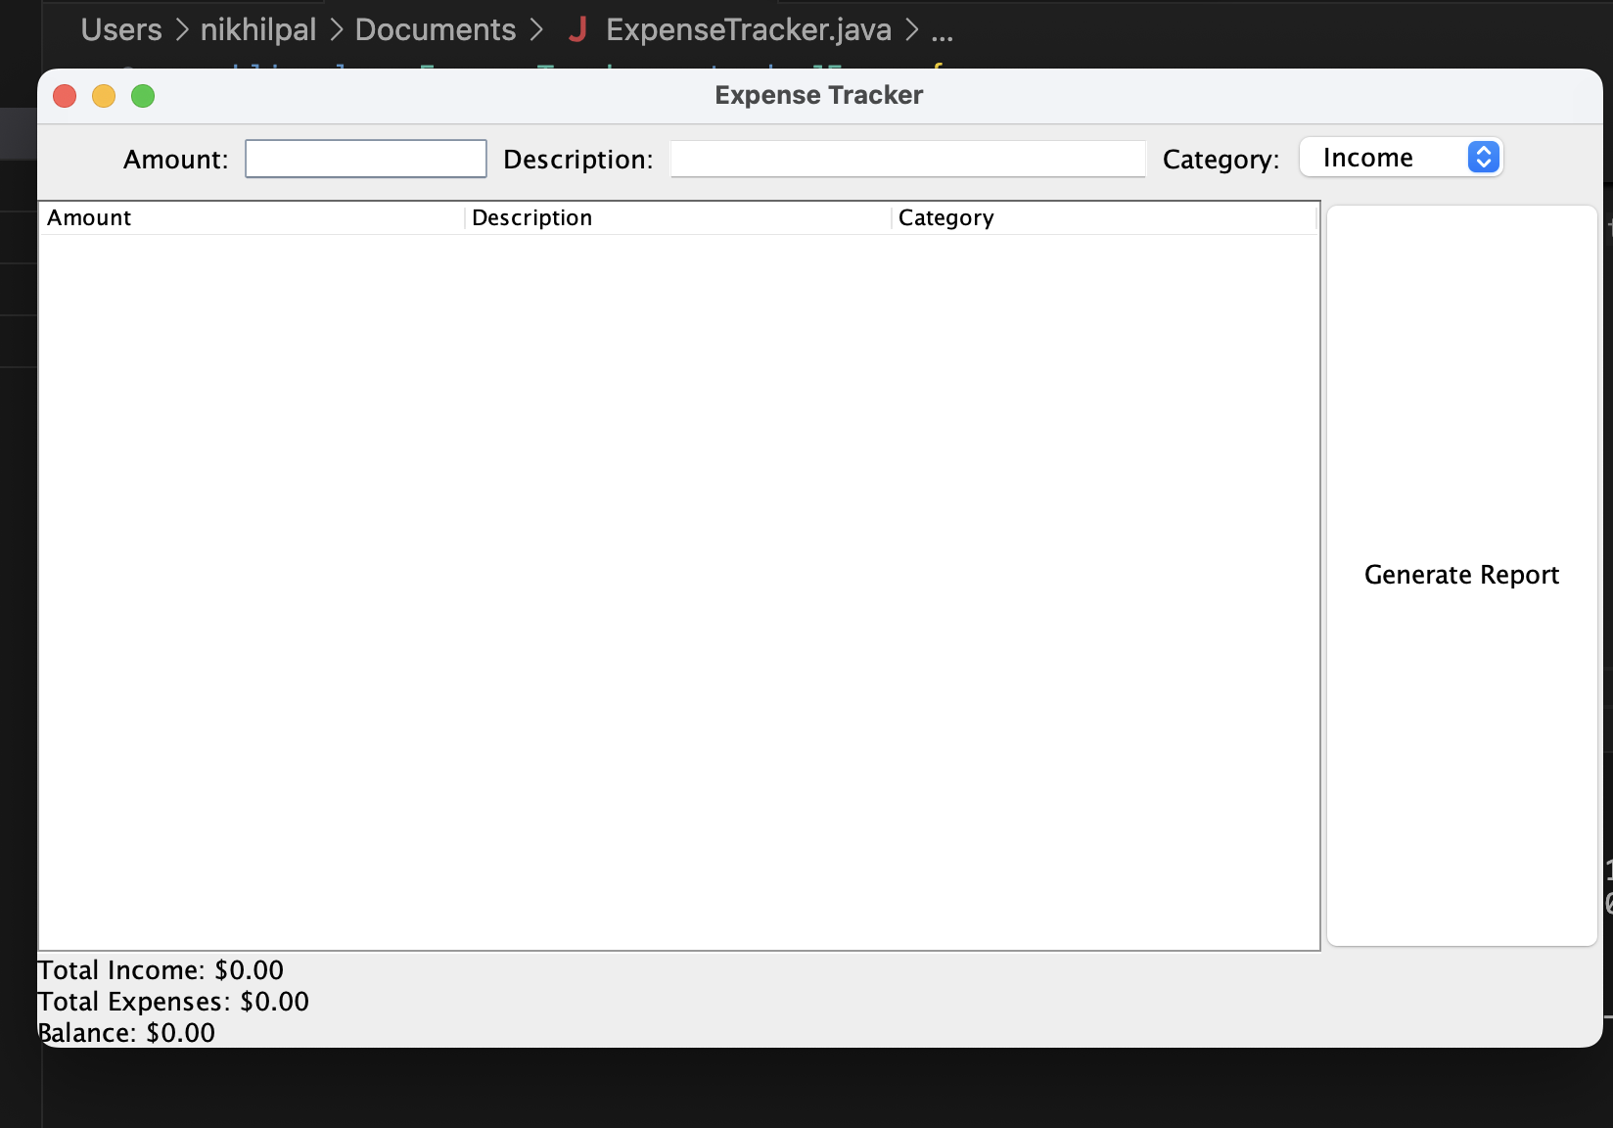
Report Generation:
The user can click a "Generate Report" button, which produces a summary of expenses by category in a new window.

Slide 6
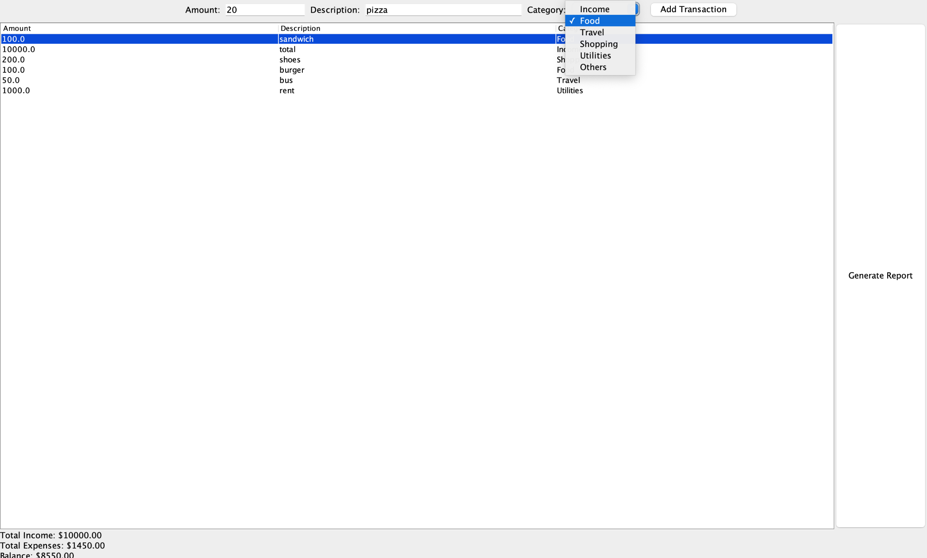

Slide 7
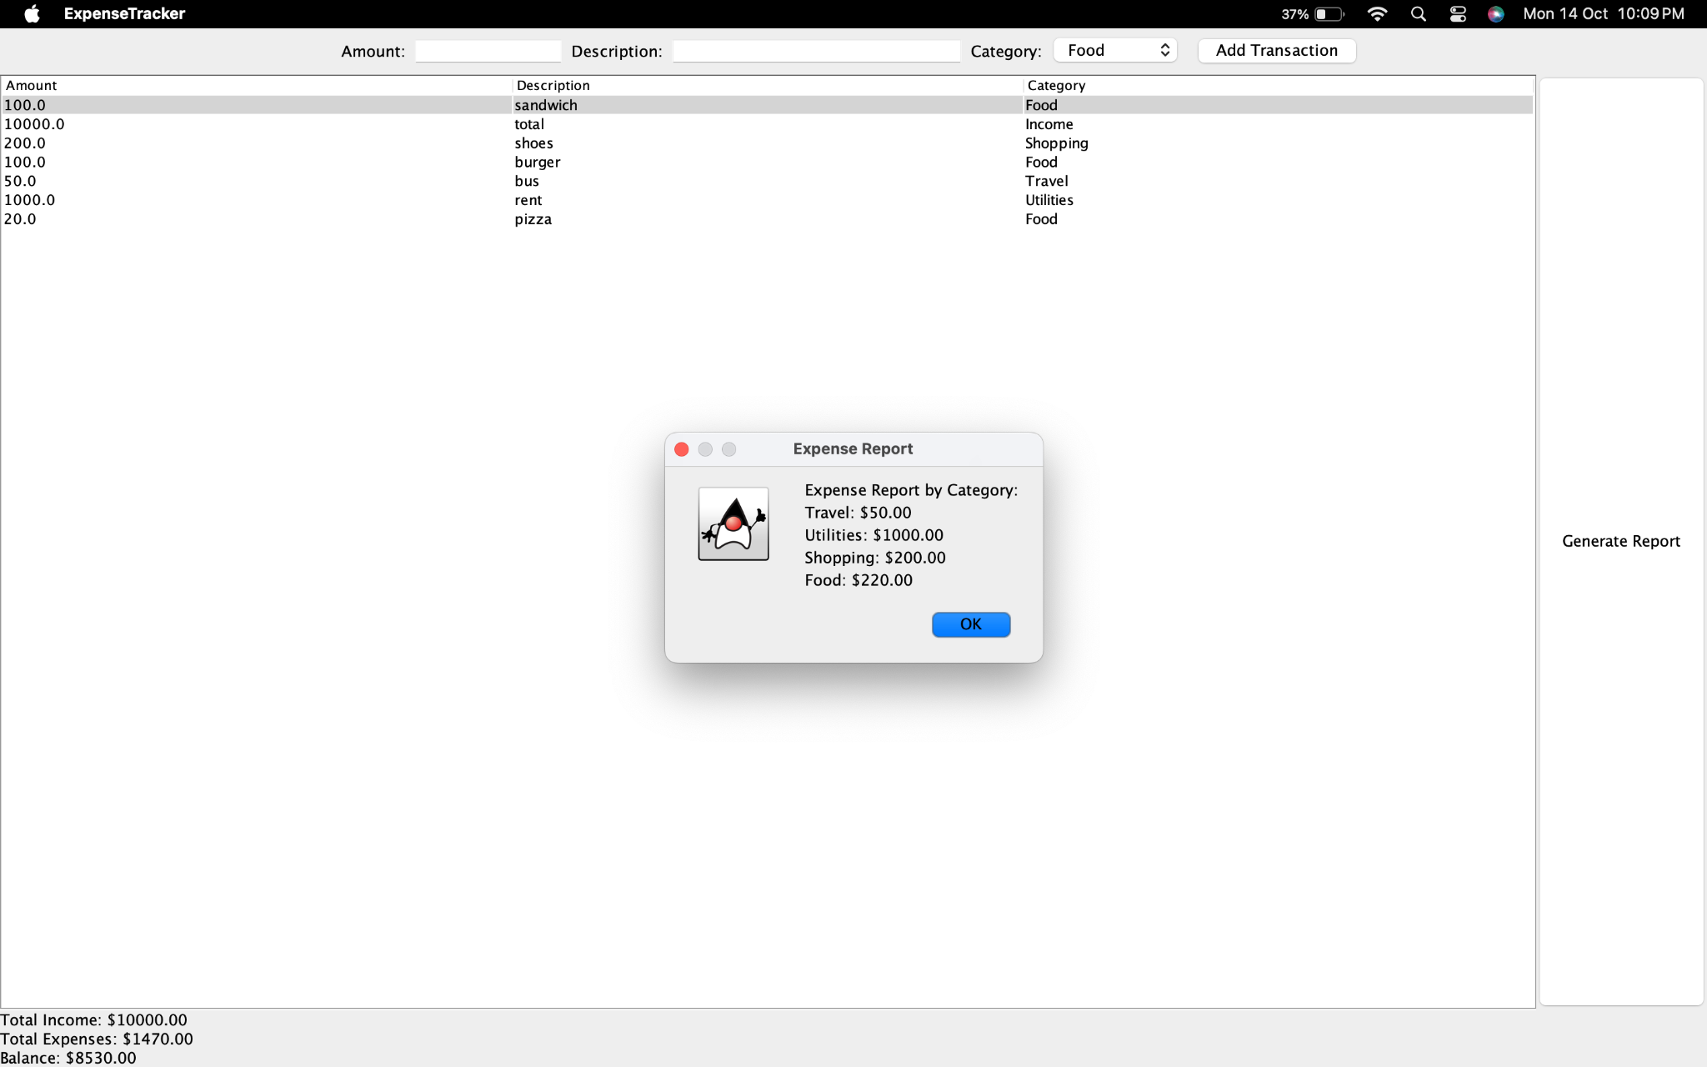

Slide 8
RESULTS
The app successfully tracks the user’s income and expenses and calculates the current balance in real-time.
User-Friendly Interface:
A clear, intuitive interface allows users to easily input and review transactions.
Efficient Data Handling:
The transactions are stored in a JTable for easy retrieval and modification.
Dynamic Report Generation:
The report generation feature helps users analyze their spending patterns across categories (e.g., food, travel, shopping).
Reports show a detailed breakdown of expenses by category, helping users make informed financial decisions.
Future Improvements:
Data persistence using a database or file storage.
Visualization of expense reports using pie charts or bar charts.

